Slide 1
DATA MINING TECHNIQUES REVIEW 2
ITE2006
E1+TE1
MOVIE RECCOMNDATION SYSTEM

Slide 2
TEAM MEMBERS
NAME | REG NO
CHINMAY CHATURVEDI | 15BIT0177
RUSHIKESH BABAR | 15BIT0057
SUMIT PATIL | 15BIT0033
SHRADDHA GUPTA | 15BIT0005
Faculty : Prof .Thippa Reddy

Slide 3
Overview
Introduction
Objective
Pre-Processing
Requirements
Screenshots

Slide 4
Introduction
The Indian movie industry produces the maximum number of movies per
year at 1000/year, higher than any other country’s movie industry.
The IMDb is an excellent resource to find detailed information about
almost any film ever made. It contains a vast amount of data, which
undoubtedly contains much valuable information about general trends in
films.
Data mining techniques allows us to RECOMMEND THE MOVIE , according to the likes and dislikes of the user .So we will get the
data from IMDb and predict the movie success by applying the
mathematical concept.

Slide 5
Objective
India, is a movie fanatic nation, but there is no composite movie
database or a credible source for movie-ratings
There are thousands of movies world wide.
This system will suggest the user which movie he/she should watch based on the movie which user has already or he wants to see.
We have taken the movie data set from website kaggle.com.
It has data of about 5000 movies.
We have used rapid miner studio tool for pre-processing.

Slide 6
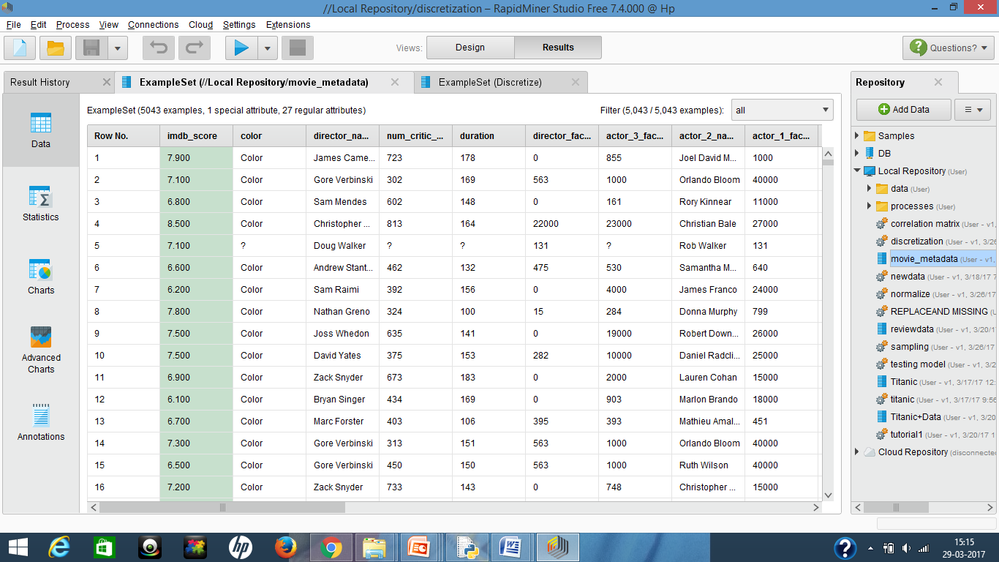
DATA SET

Slide 7
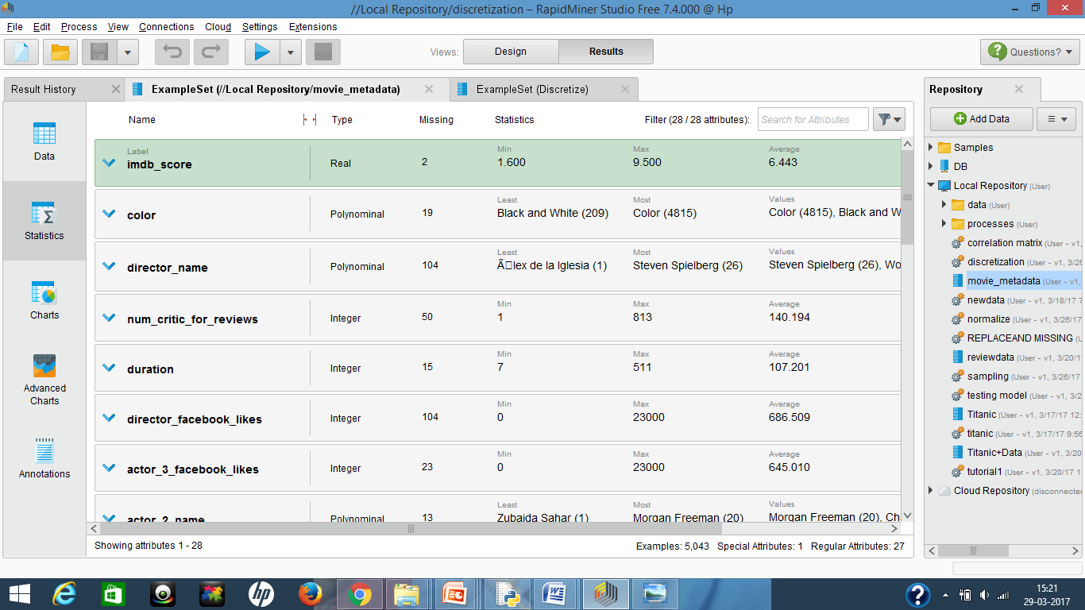
STATISTICS

Slide 8
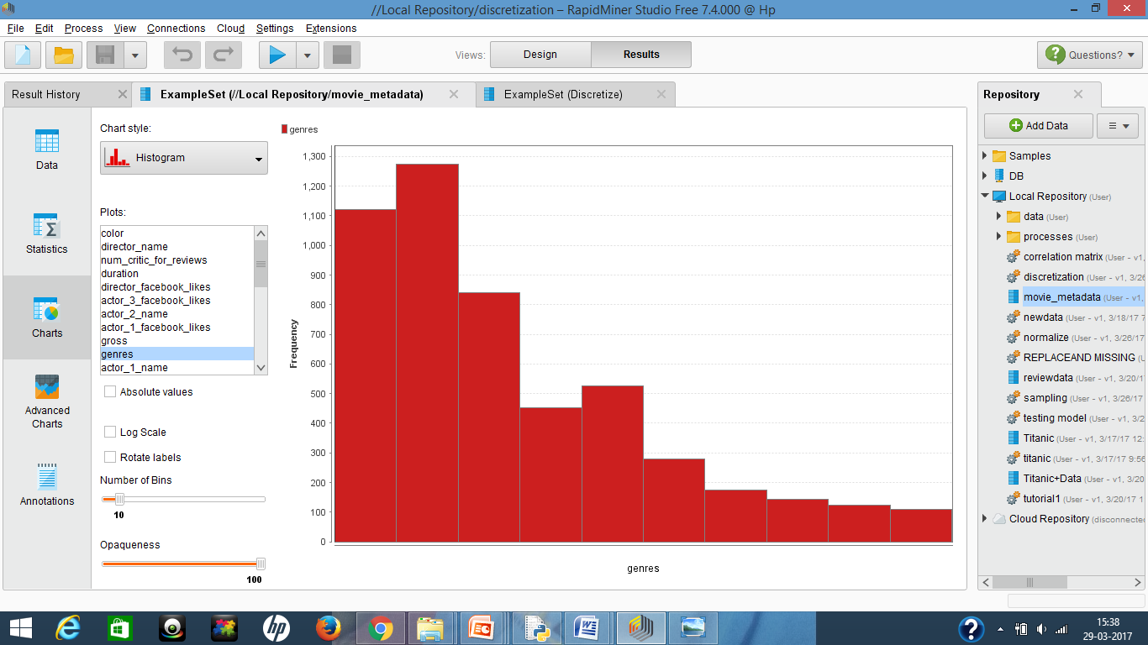
GRAPHS

Slide 9
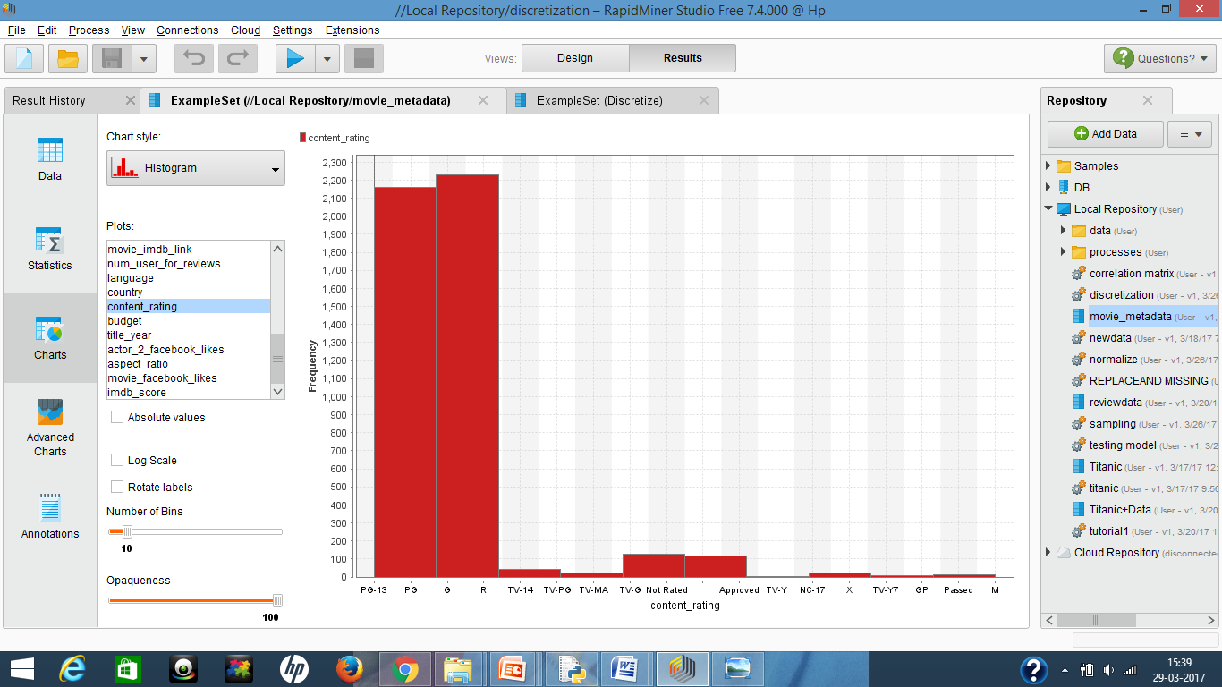

Slide 10
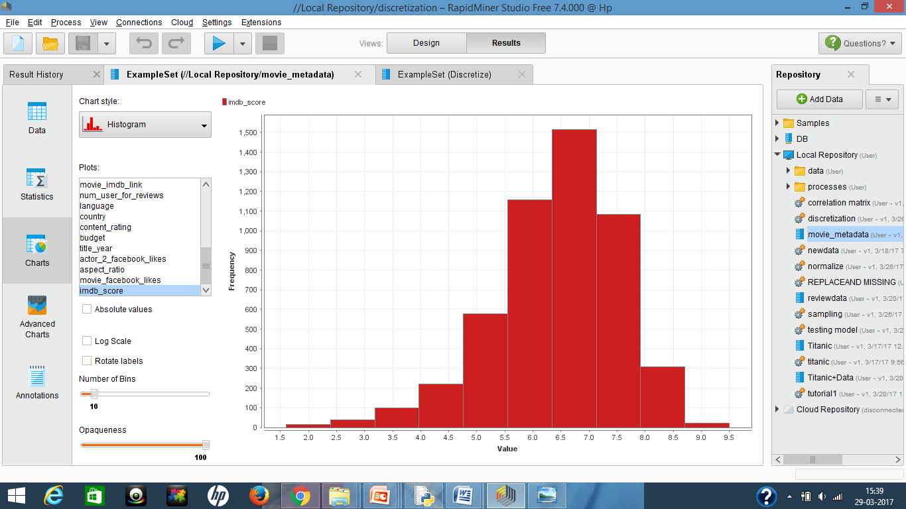

Slide 11
PREPROCESSING:
We took the dataset from Kaggle and found out that there are many missing values in the data set. So to remove the missing values we used the following techniques.
1.Filter Examples: Removes the rows which has any missing value.
2.Replace missing values: In it missing values are replaced by the average value of that attribute
3.Discretization by frequency and binning.
4.Normalization
5.Sampling
6.Corelation Matrix

Slide 12
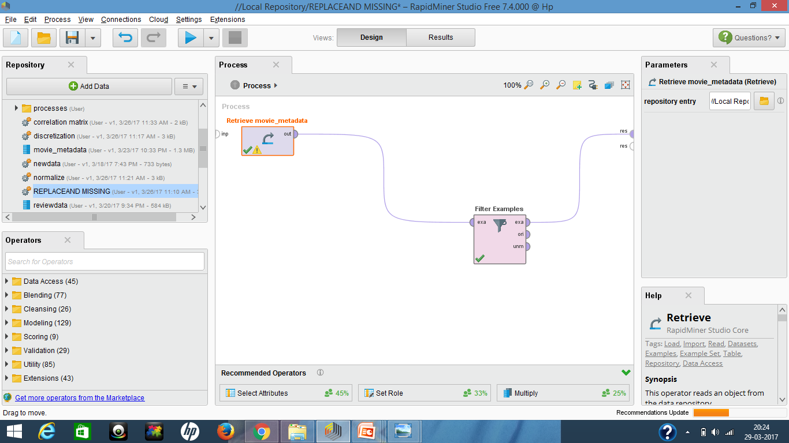
PREPROCESSING THROUGH FILTER EXAMPLES OPERATOR

Slide 13
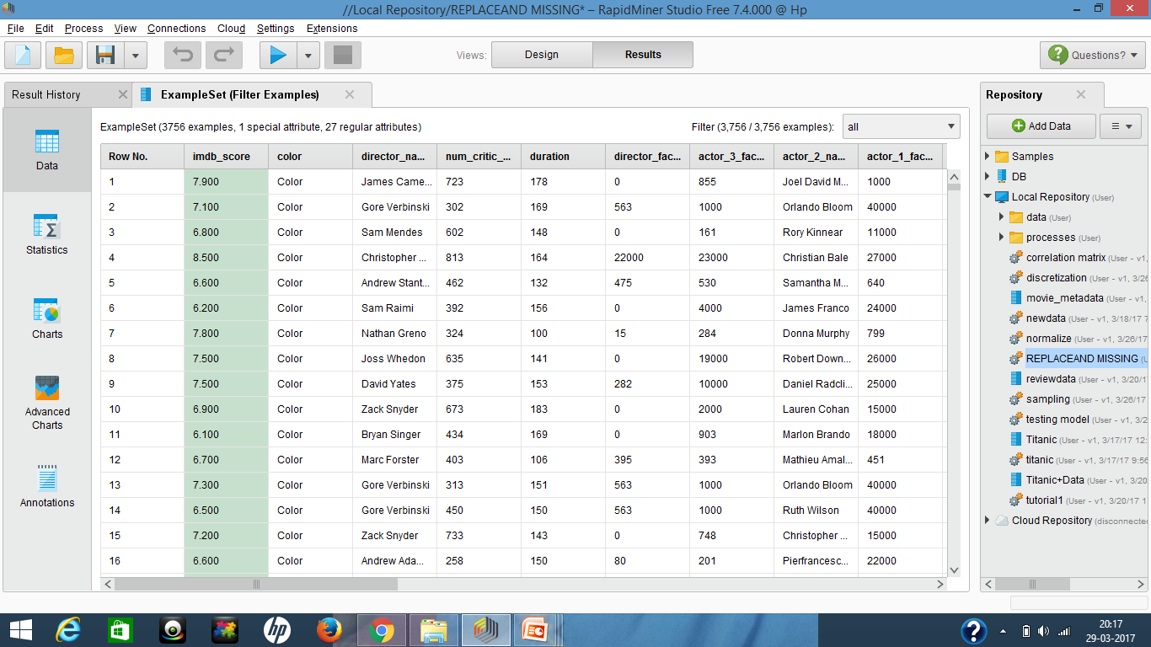
PREPROCESSING THROUGH FILTER EXAMPLES OPERATOR

Slide 14
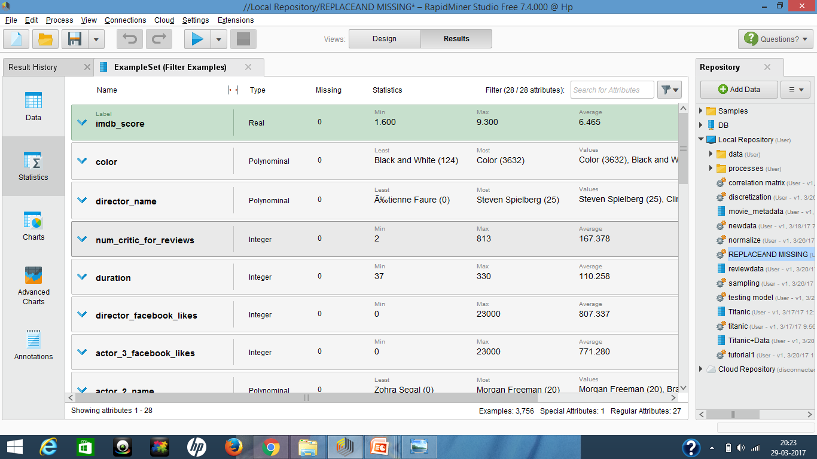
PREPROCESSING THROUGH FILTER EXAMPLES OPERATOR

Slide 15
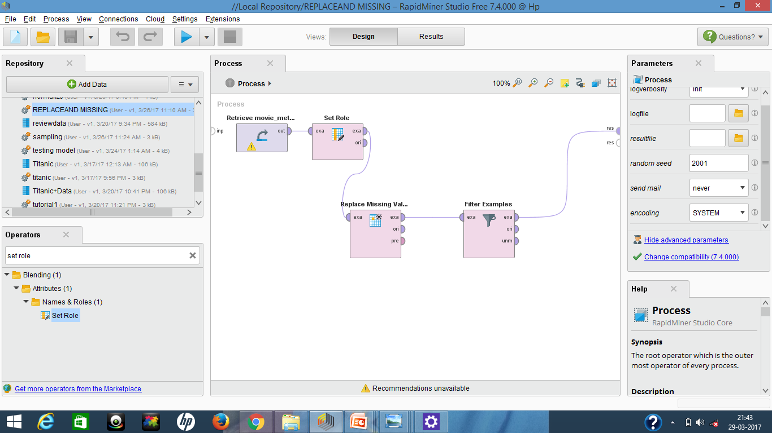
PREPROCESSING THROUGH REPLACE MISSING VALUES OPERATOR

Slide 16
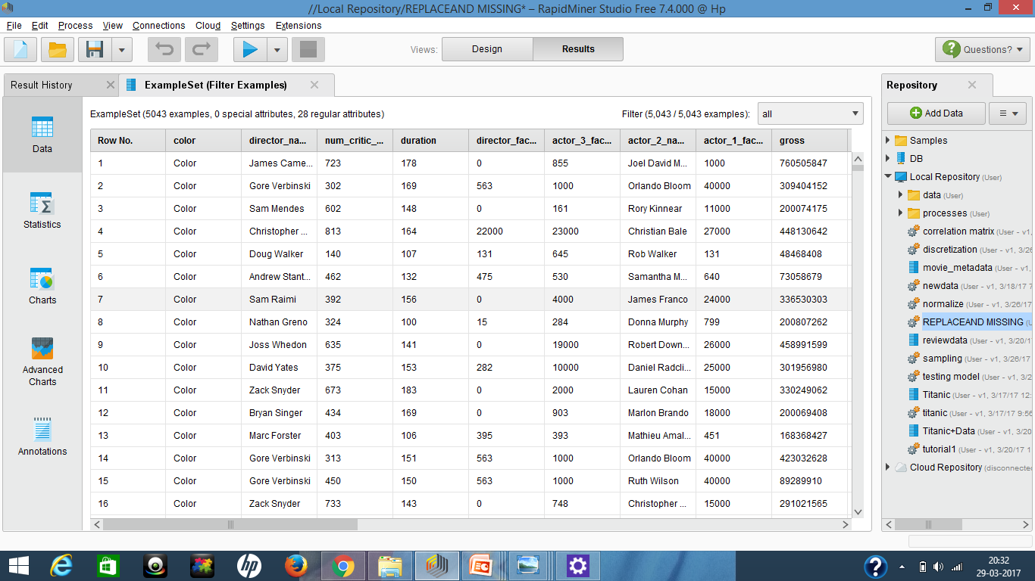
PREPROCESSING THROUGH REPLACE MISSING VALUES OPERATOR

Slide 17
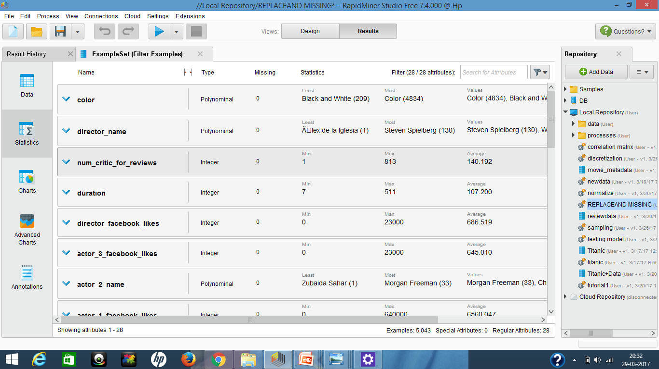
PREPROCESSING THROUGH REPLACE MISSING VALUES OPERATOR

Slide 18
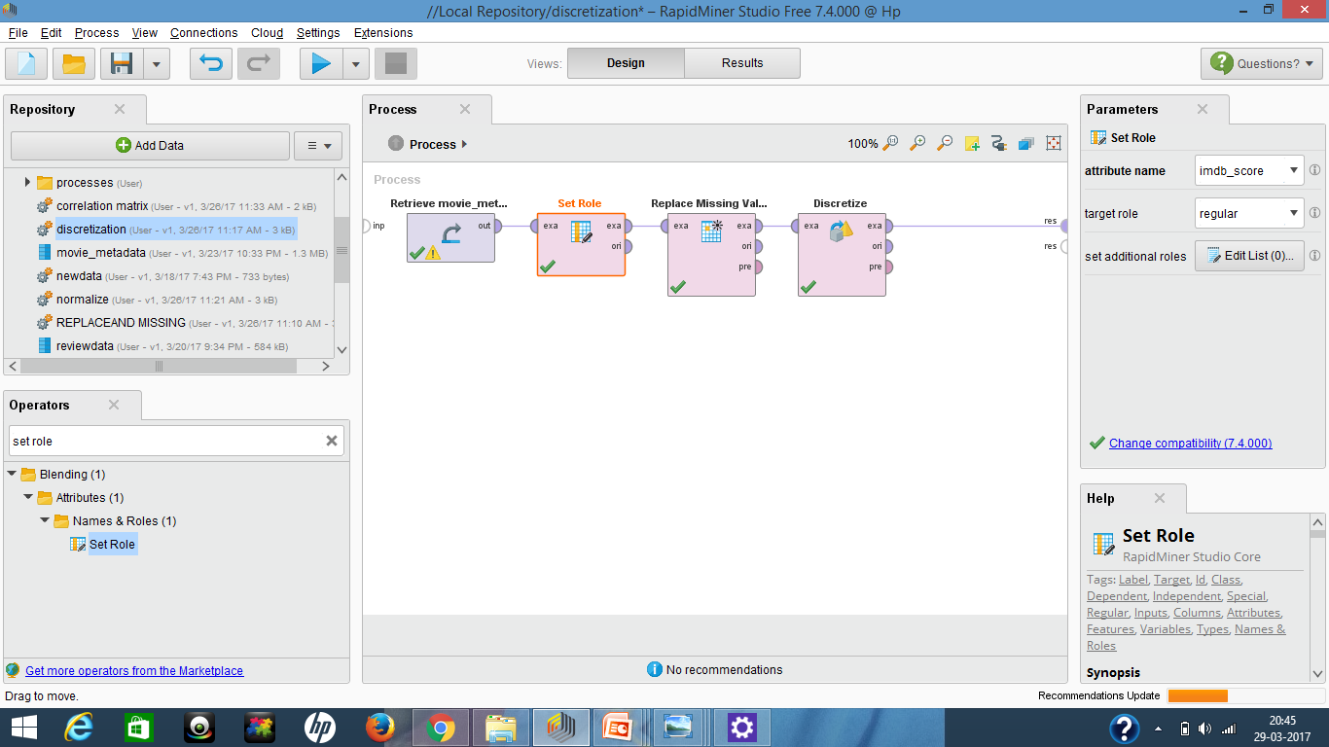
PREPROCESSING THROUGH DISCRETIZATION (frequency)OPERATOR

Slide 19
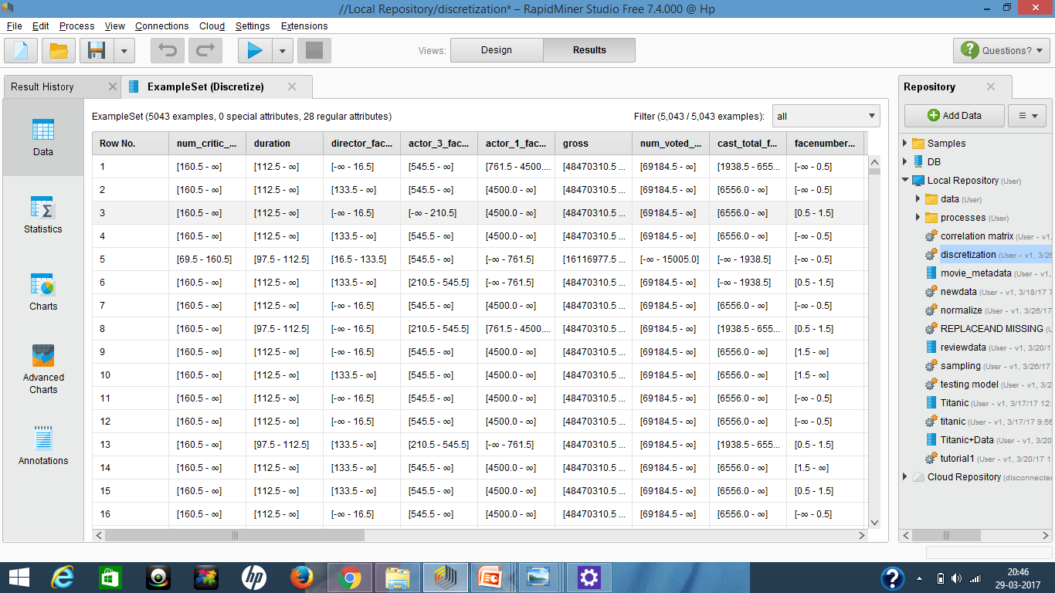
PREPROCESSING THROUGH DISCRETIZATION (frequency)OPERATOR

Slide 20
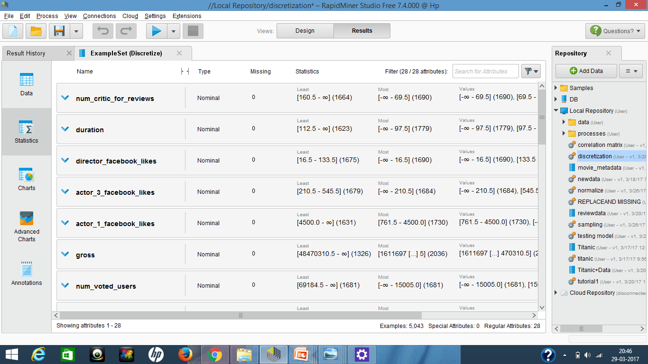
PREPROCESSING THROUGH DISCRETIZATION (frequency)OPERATOR

Slide 21
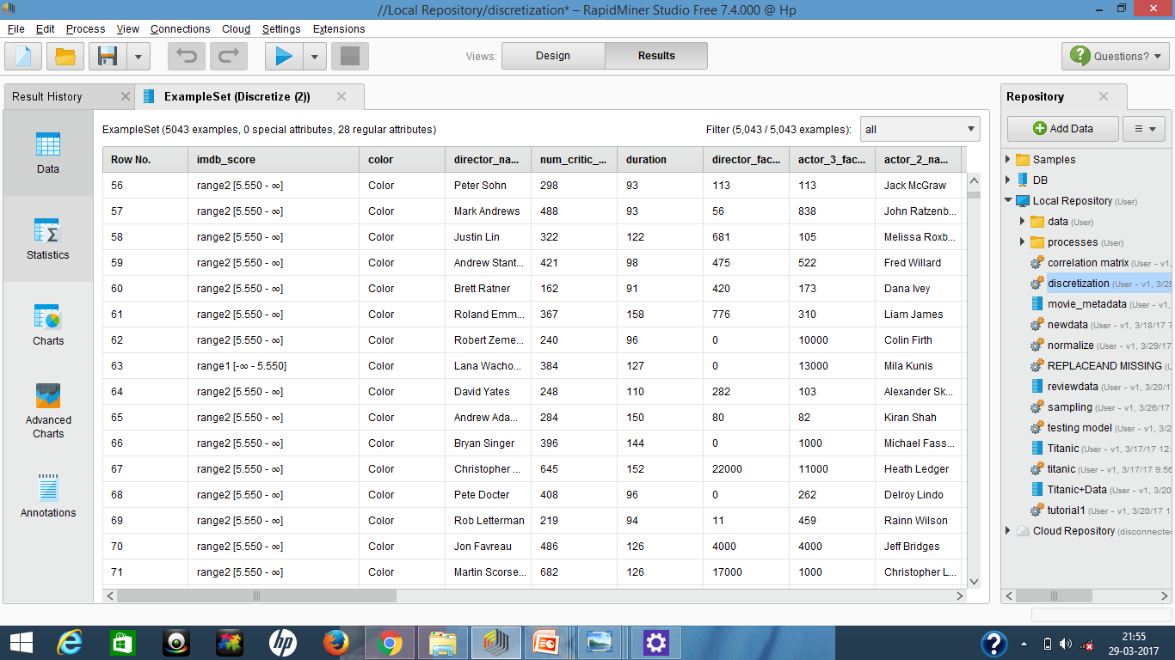
PREPROCESSING THROUGH DISCRETIZATION (binning)OPERATOR

Slide 22
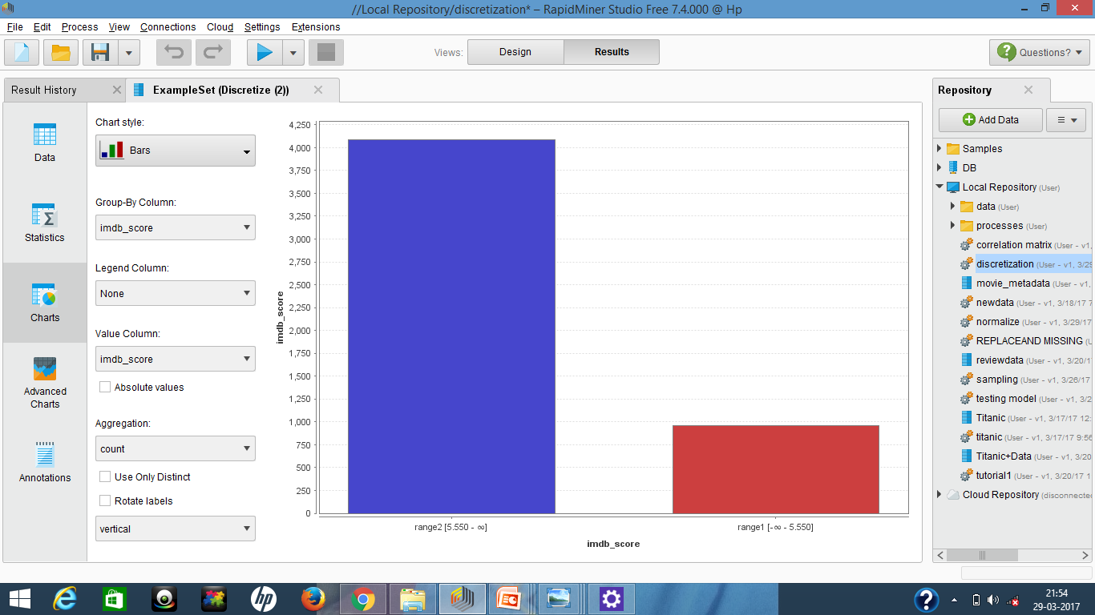
PREPROCESSING THROUGH DISCRETIZATION (binning)OPERATOR

Slide 23
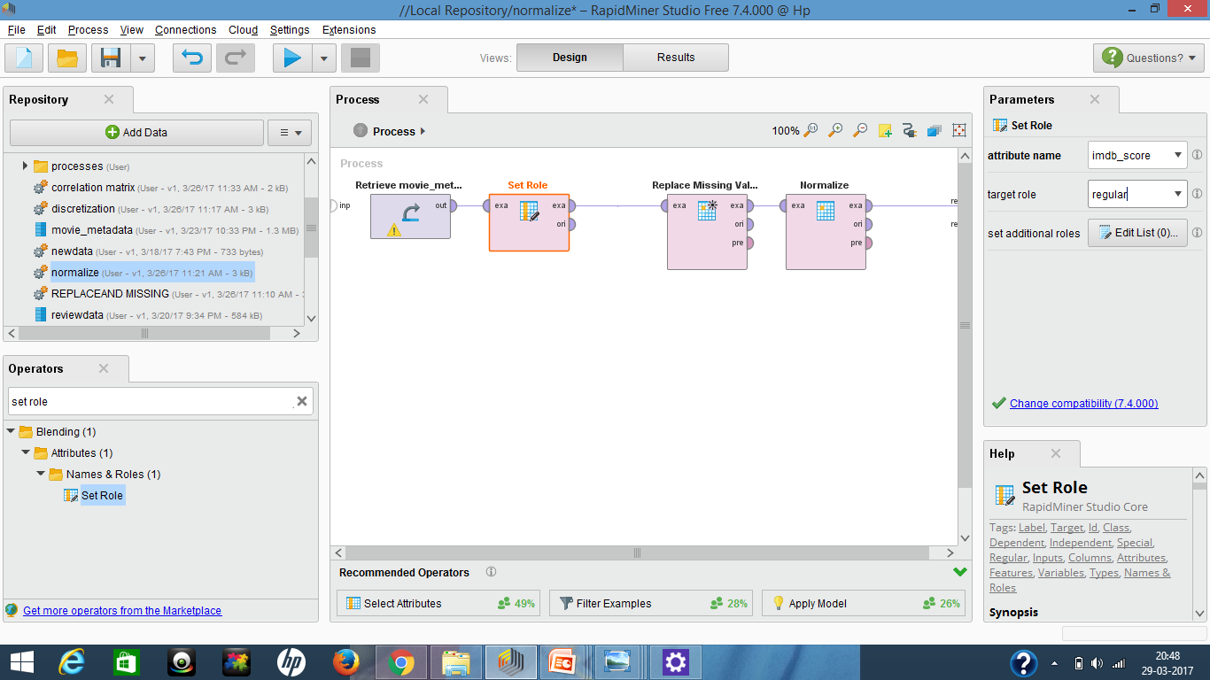
PREPROCESSING THROUGH NORMALIZATION OPERATOR

Slide 24
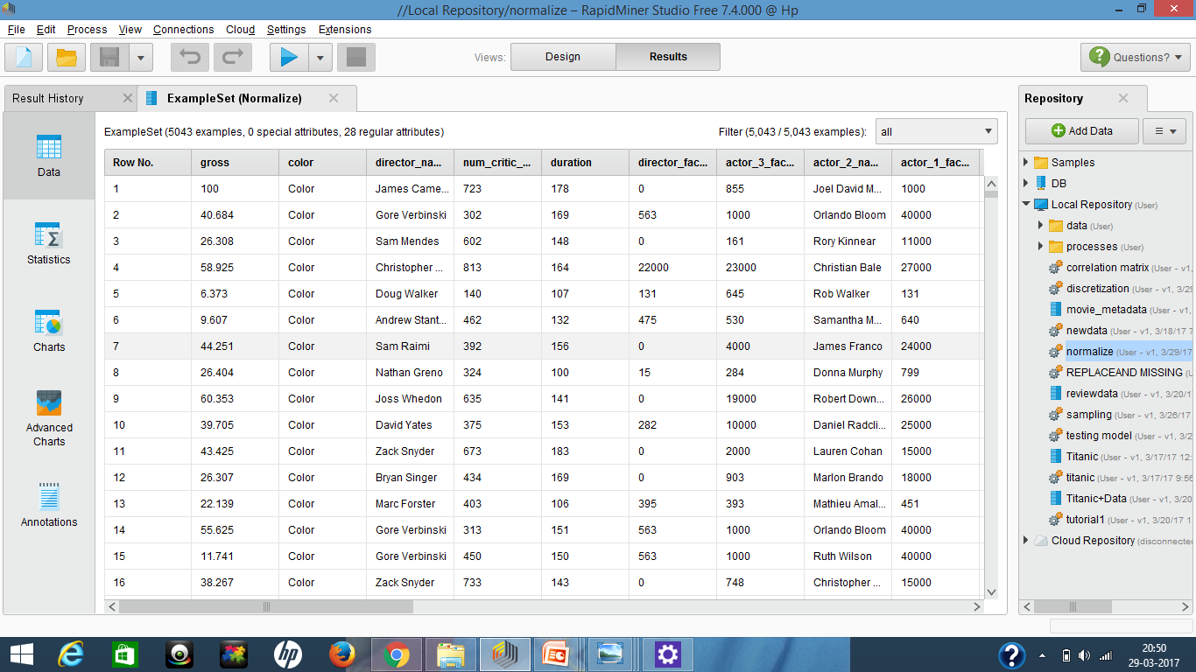
PREPROCESSING THROUGH NORMALIZATION OPERATOR

Slide 25
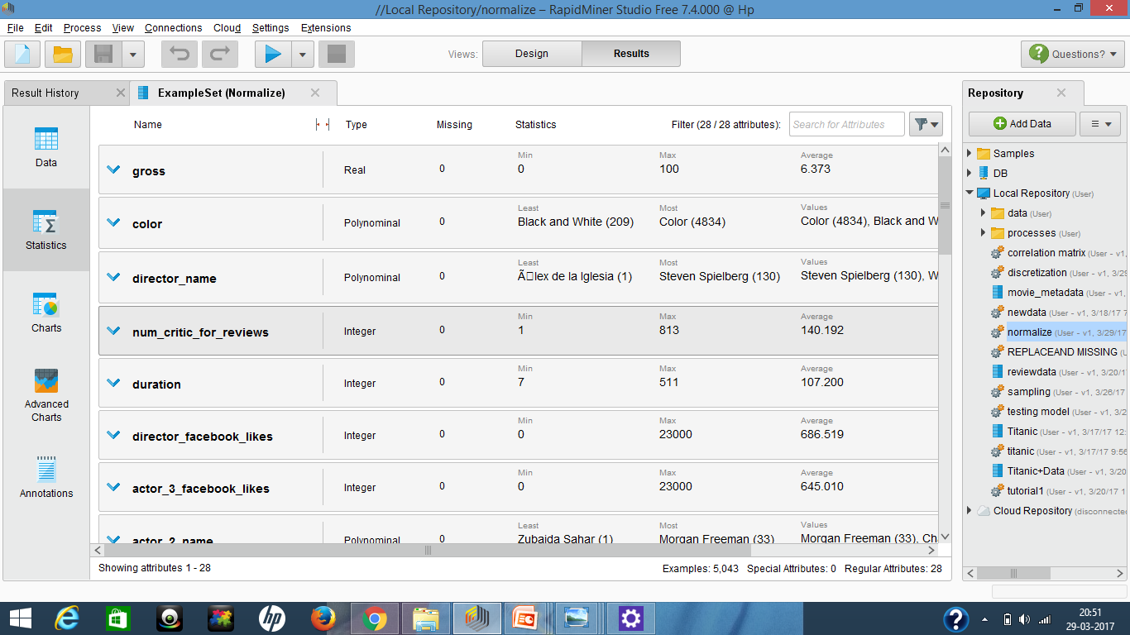
PREPROCESSING THROUGH NORMALIZATION OPERATOR

Slide 26
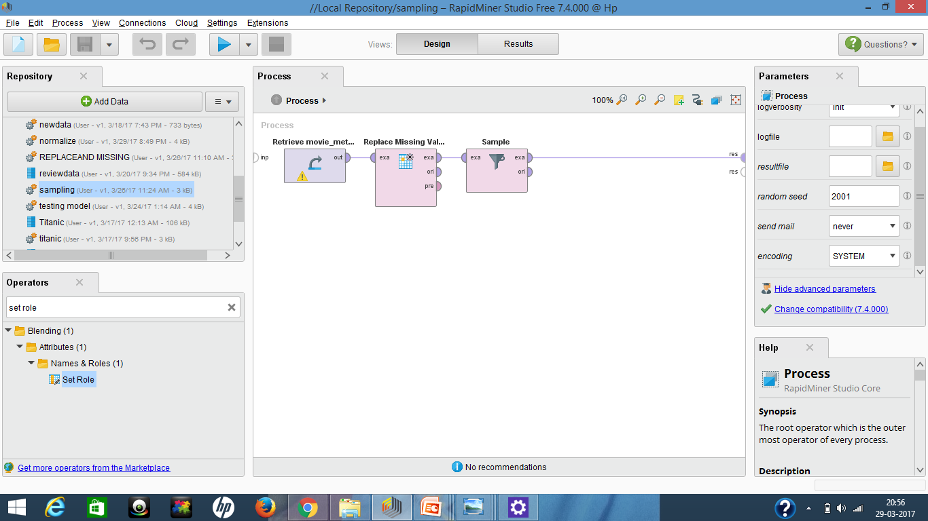
PREPROCESSING THROUGH SAMPLE OPERATOR

Slide 27
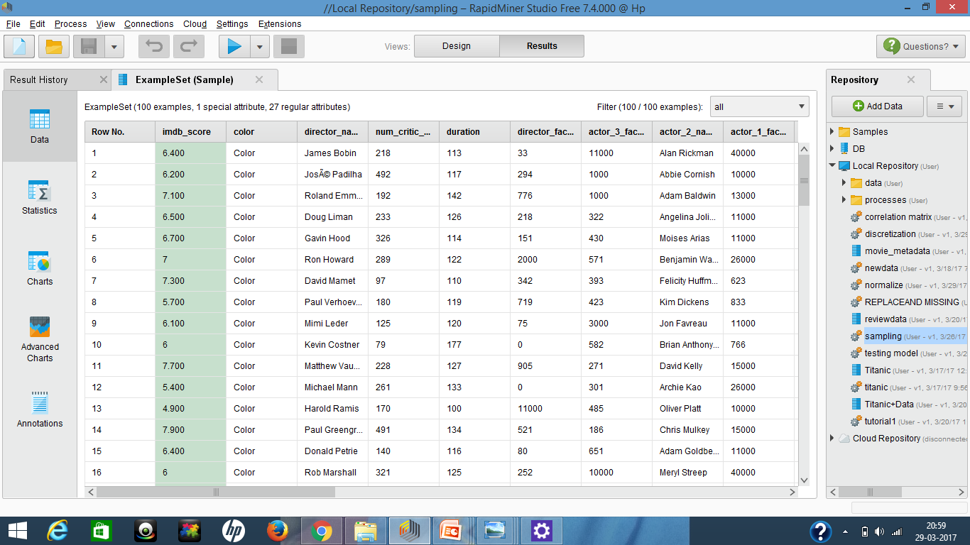
PREPROCESSING THROUGH SAMPLE OPERATOR

Slide 28
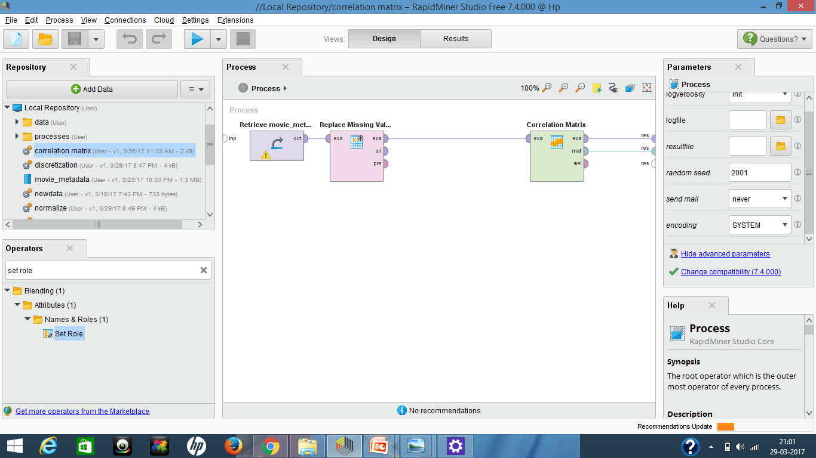
CO-RELATION MATRIX

Slide 29
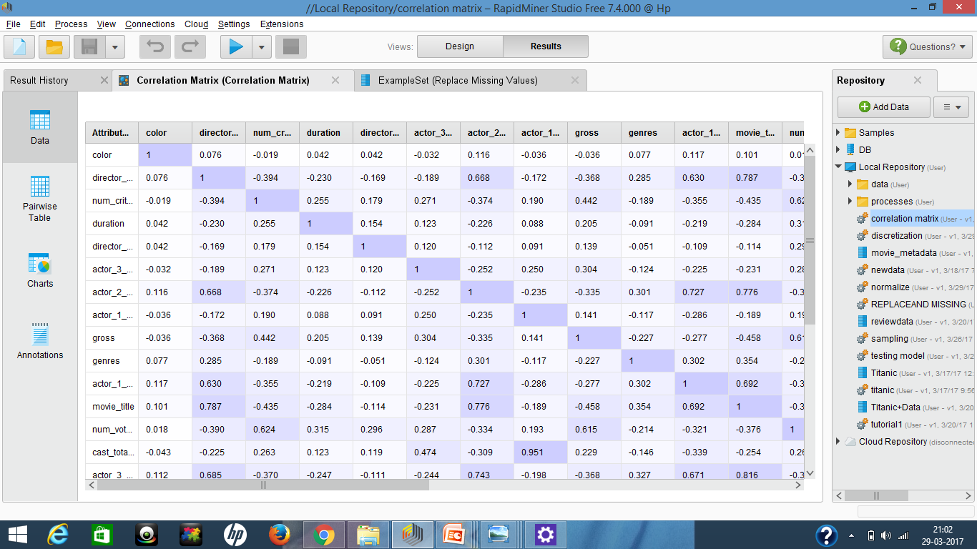
CO-RELATION MATRIX

Slide 30
Requirements
INTRODUCTION
OBJECTIVE
CLASSIFICATION
REQUIREMENTS
FEATURES
ADVANTAGES
Software Requirements:
* Windows
* Wampserver
* MySql
Hardware Requirements:
* Processor – Pentium IV
* 64 bit operating system
* Hard Disk – 70GB
* Memory – 2GB RAM

Slide 31
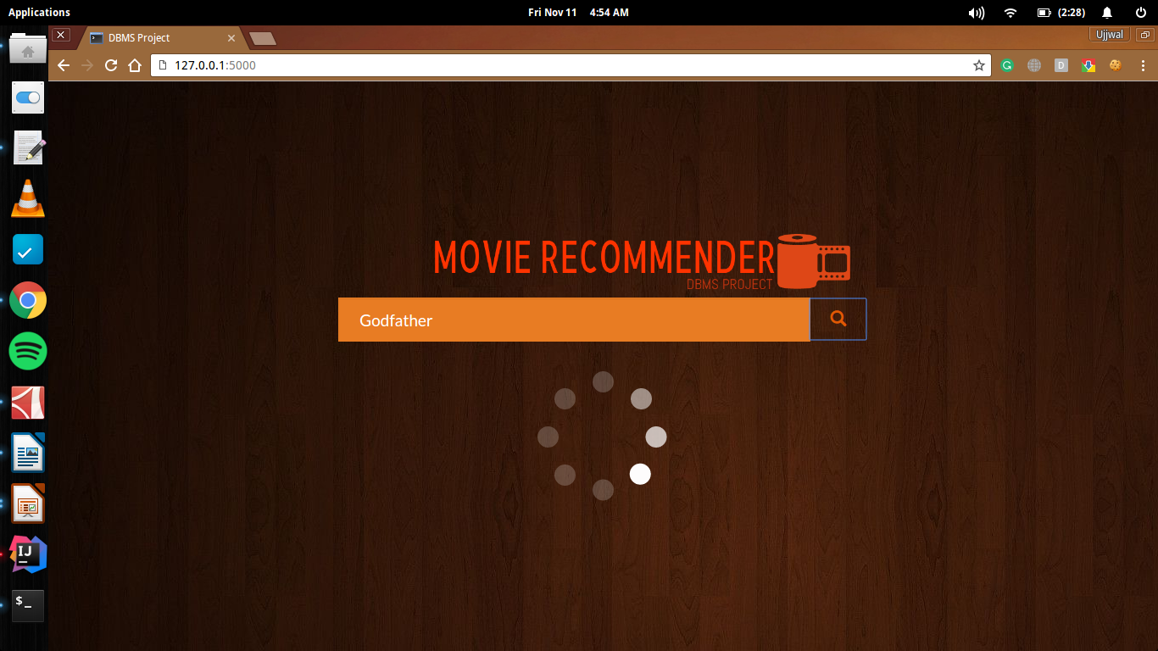

Slide 32
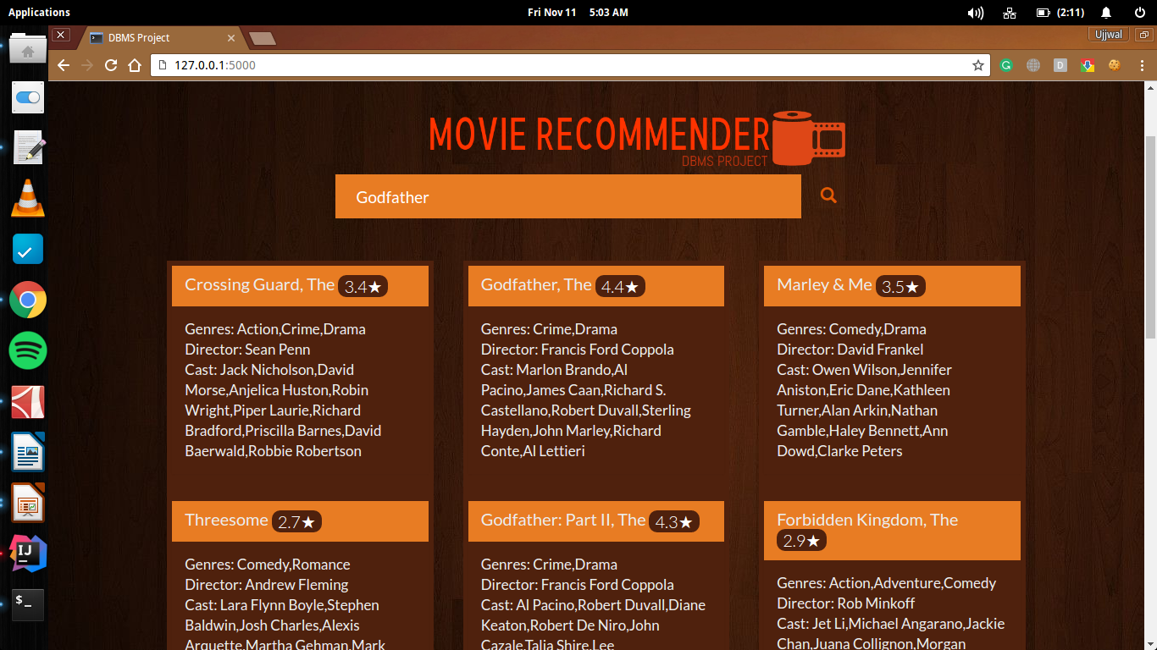

Slide 33
THANK YOU

